Slide 1

Physical Education and Health
Learning and Evaluation Situation
Elementary 2
Competency 2:
Interacts with others in different physical activity settings

Slide 2
Principles of balance
Slides S1 to S3

Slide 3
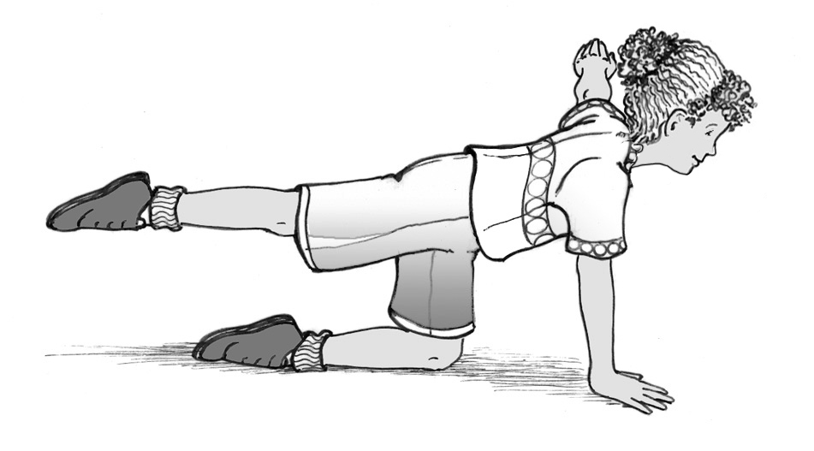
S1
Arm extended horizontally
to the side
Upper body straight
Leg extended backward horizontally
Arm extended to the floor
Knee, leg and the top of the foot supporting the body
Hand in line with the shoulder

Slide 4
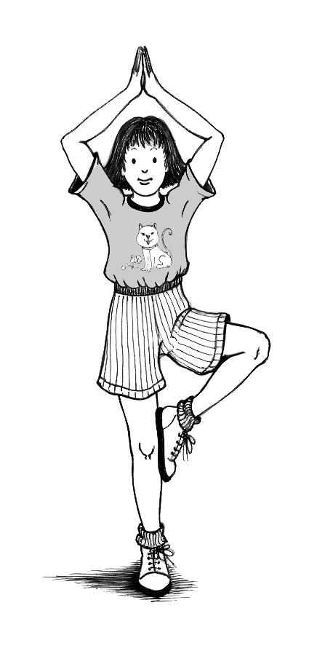
Hands flat, pointing upward above the head
S2
Arms and forearms forming a diamond
Upper body straight
Knee to the side
Foot placed on the side of the knee
Leg extended

Slide 5
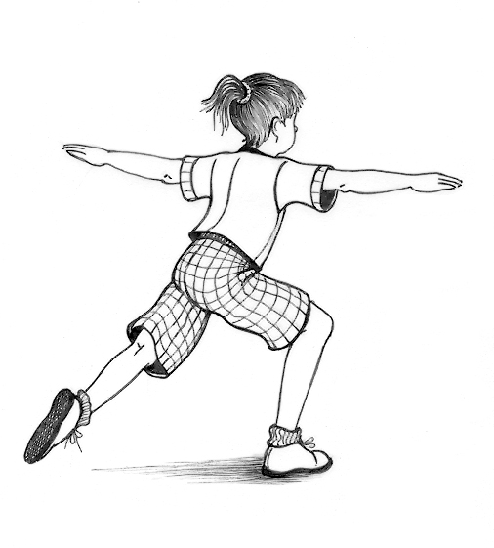
S3
Arms extended to the side
Eyes focused forward
Upper body straight
Leg extended
Leg partially bent

Slide 6
Solidity of a structure
and surface area of support points
Slides S4 to S8

Slide 7
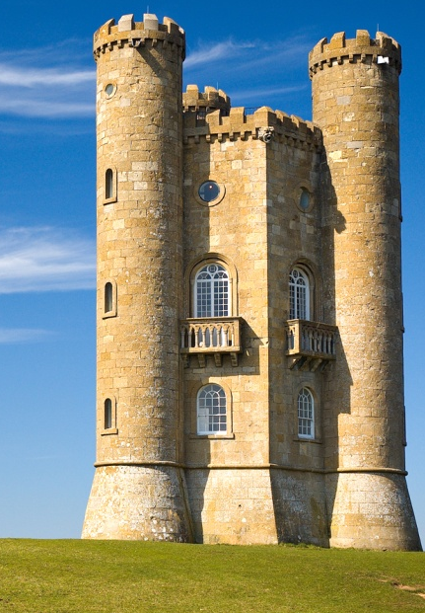
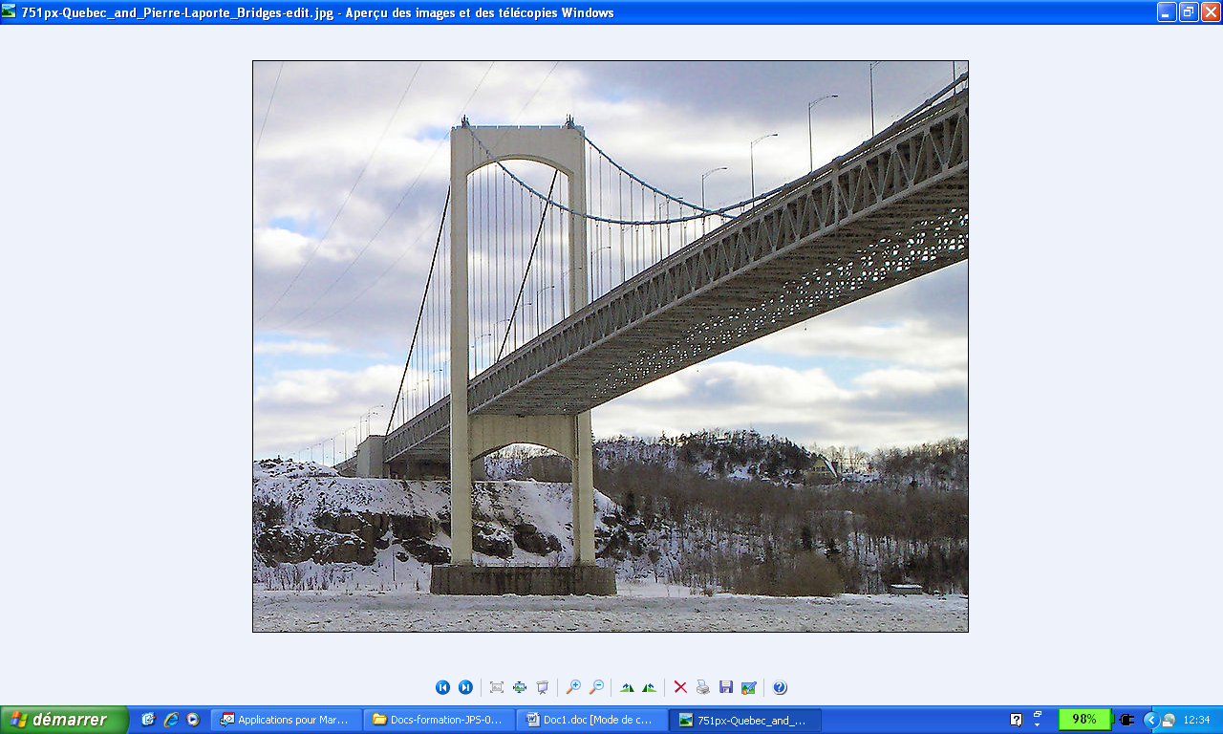
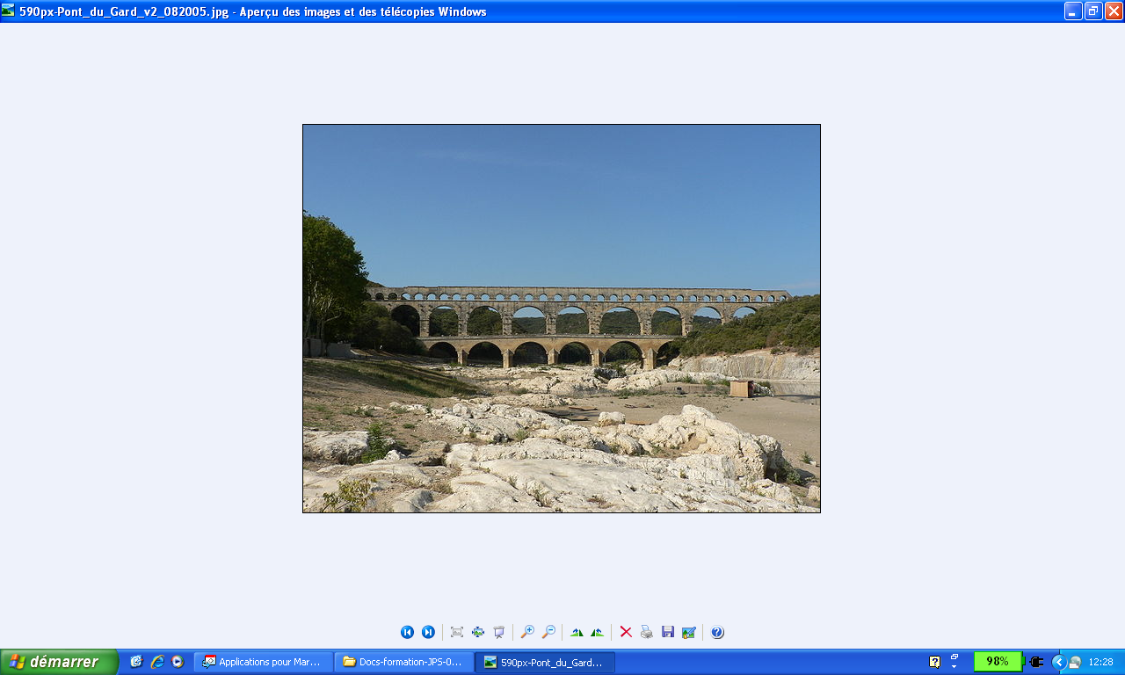
S4
Knowledge: principles related to group figures with a partner
Why are these structures solid?
They have one or more solid bases.
Wikimedia Commons/Newton2
Wikimedia Commons/Blanchardb
There are many bases.
The bases are stable.
The bases are firmly planted.
Wikimedia Commons/Patrick Clenet

Slide 8
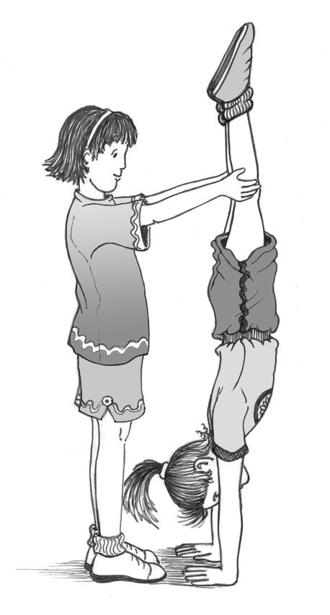
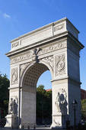
S5
Wikimedia Commons/Patrick Clenet
They have one or more solid (hard) bases.

Slide 9
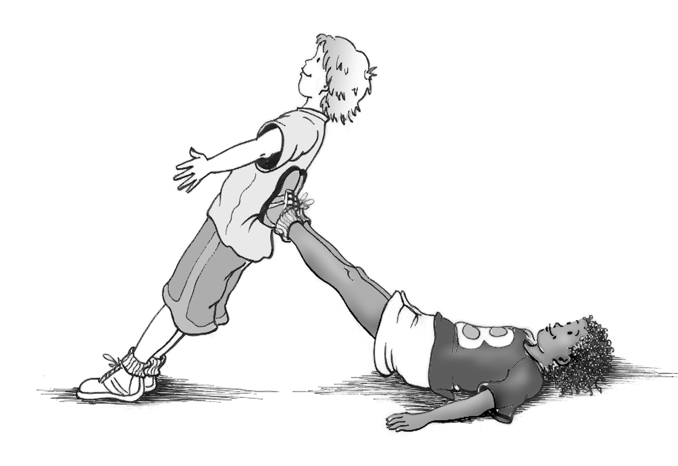
S6
The bases are stable.
Wikimedia Commons/Blanchardb

Slide 10
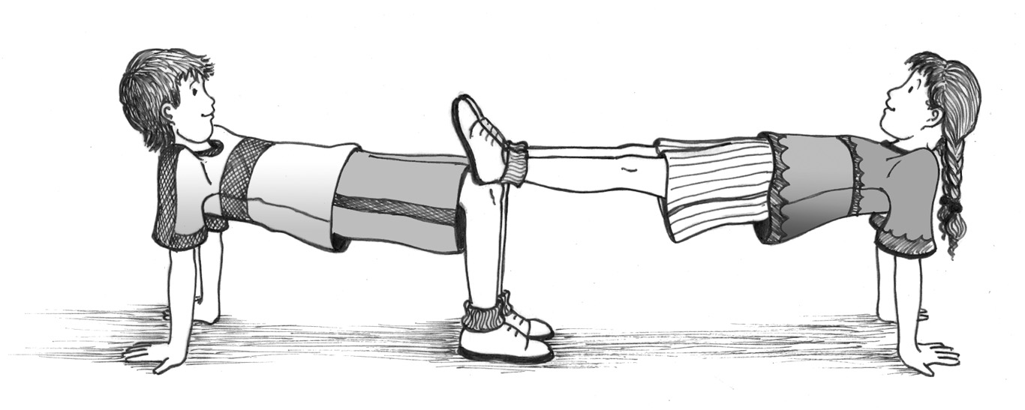
S7
There are many bases.
Wikimedia Commons/Patrick Clenet

Slide 11
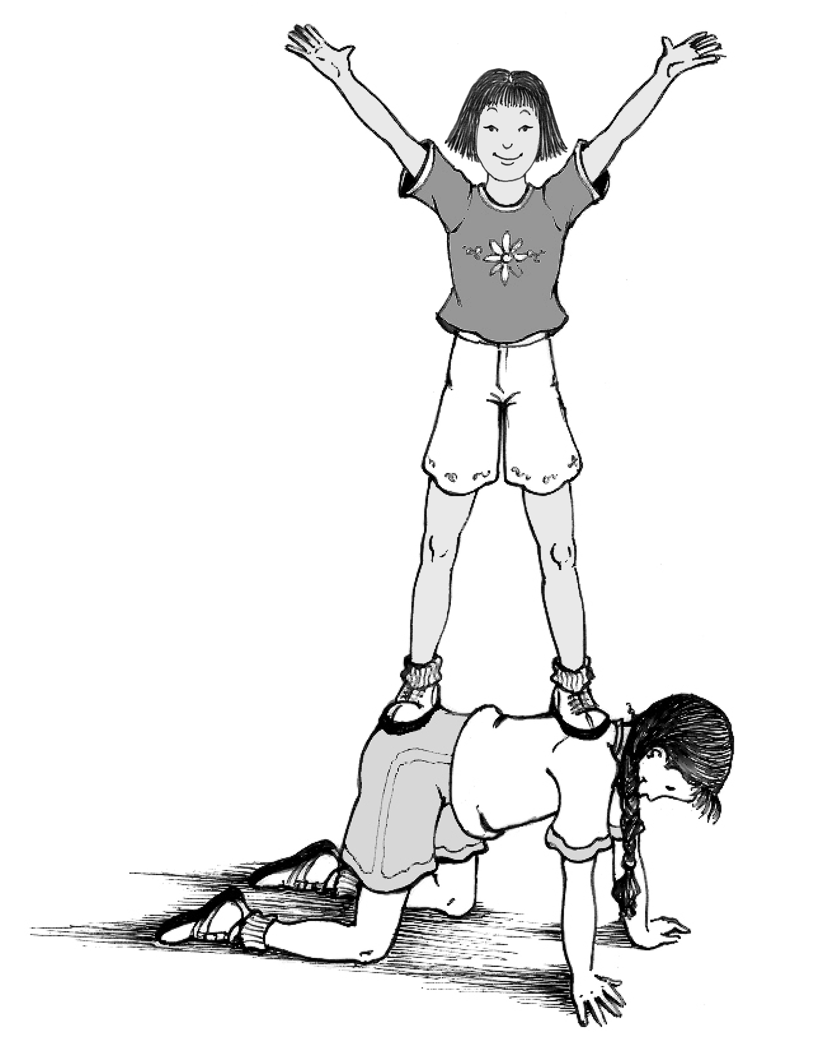
S8
Wikimedia Commons/Patrick Clenet
The bases are firmly planted.

Slide 12
Building, maintaining
and dismantling figures
AND
alignment and positioning of the support points
Slides S9 to S14

Slide 13
S9
Hands holding the knees
Arms extended
Upper body straight
and vertical
Legs straight

Slide 14
S10
Legs extended
vertically
Upper body straight
Eyes focused on the floor
Arms extended and hands on the floor supporting body

Slide 15
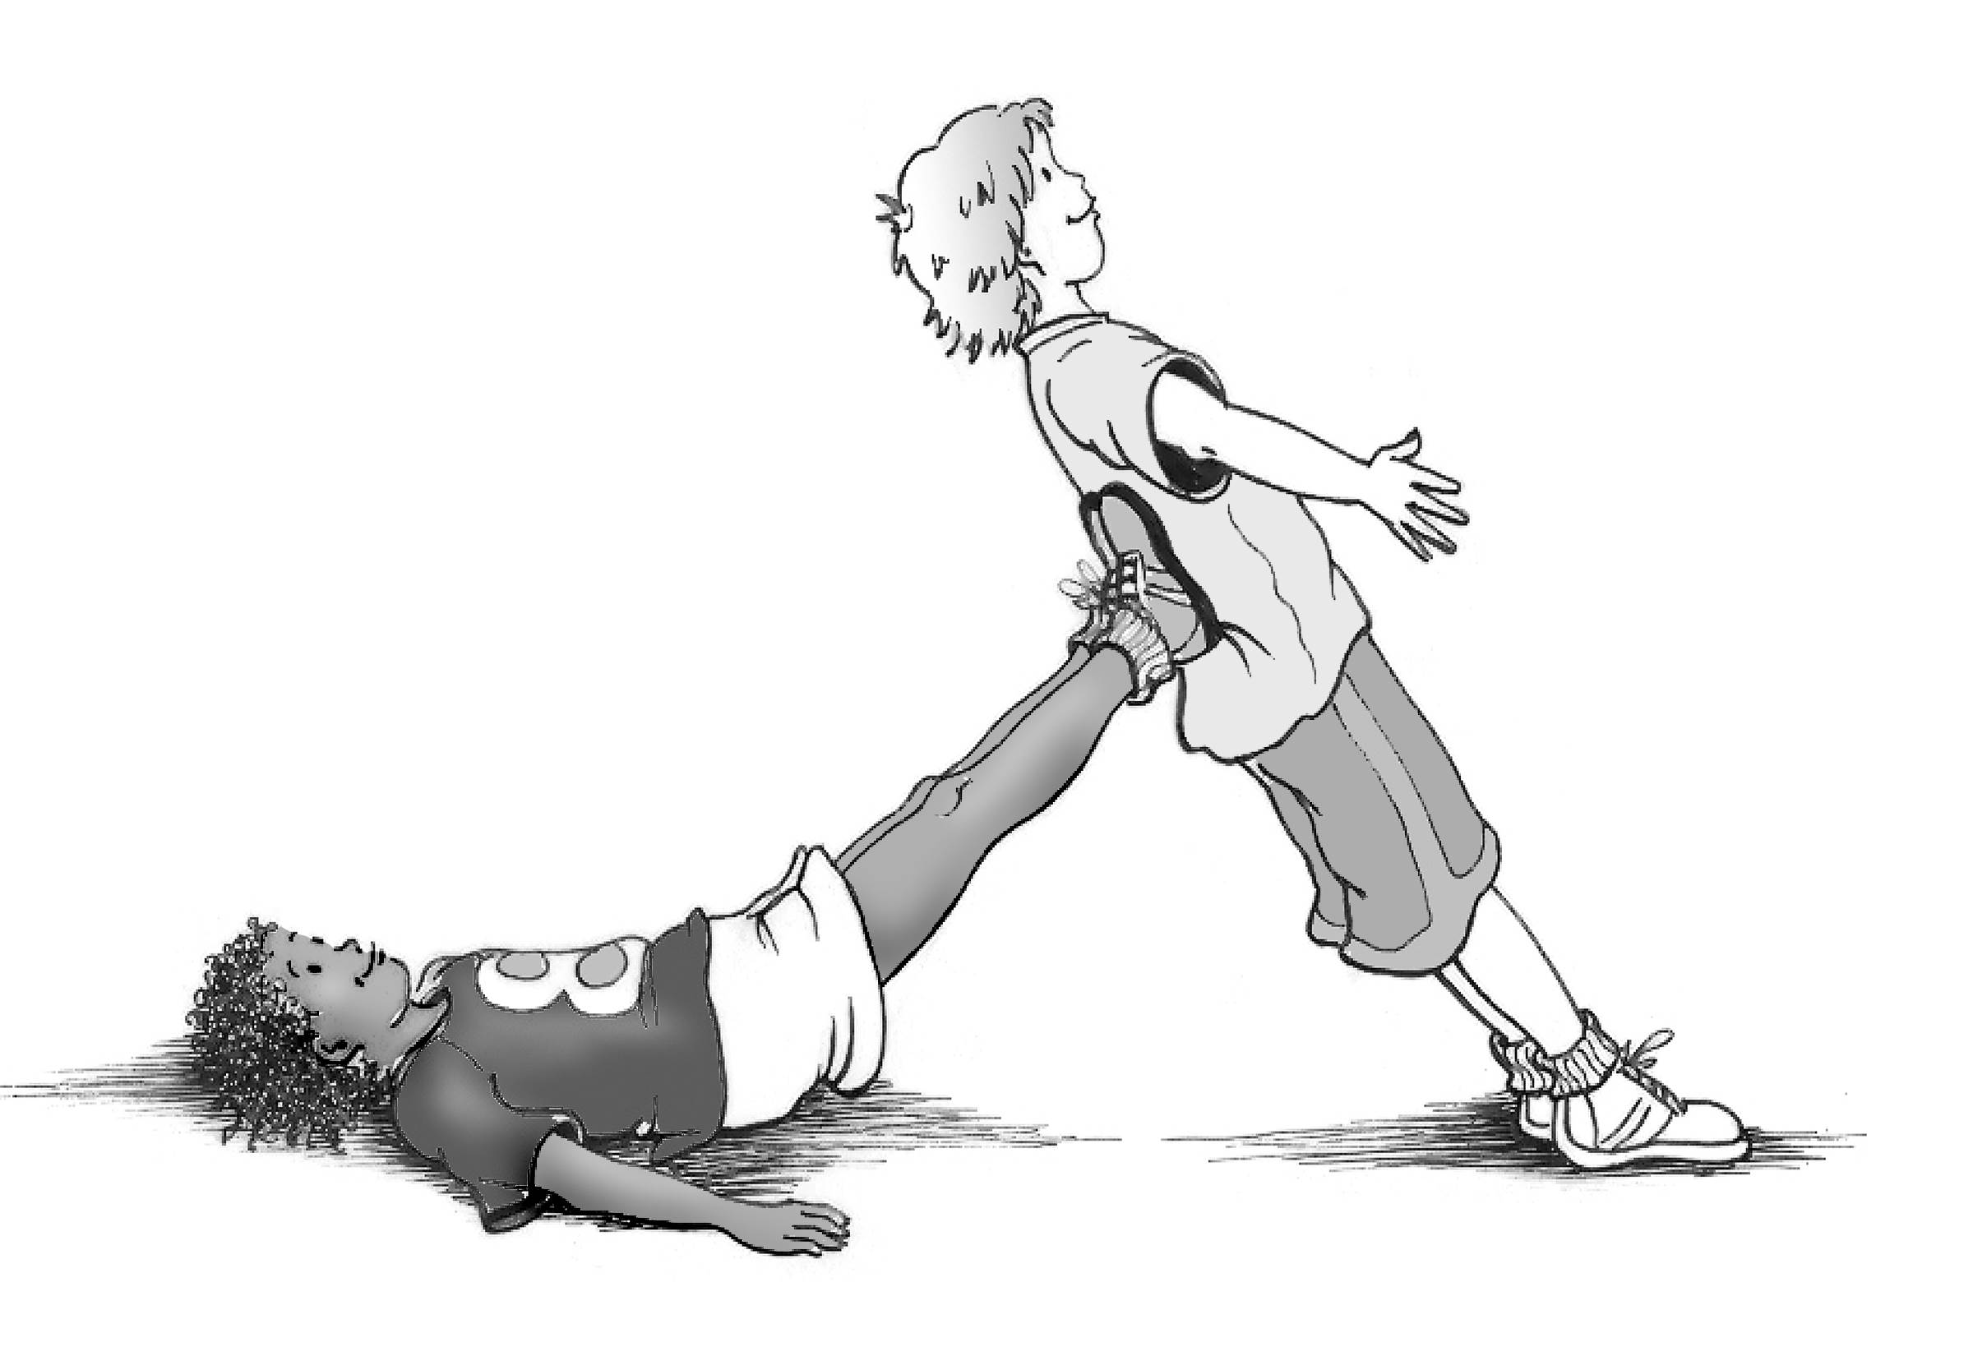
S11
Feet placed flat on the lower back
Legs straight
Arms flat on the floor, extended at an angle to the side

Slide 16
S12
Neck and head in line
with the upper body and legs
Arms extended on either side of the body
Upper body straight
and leaning back
Legs straight

Slide 17
S13
Straight upper body
and firm back
Eyes focused on the floor
Knees hip-width apart on the floor
Arms straight and hands on the floor, shoulder-width apart

Slide 18
S14
Arms extended in a “V”
Upper body straight
Legs straight
Feet placed on shoulders and hips

