Slide 1

Interactive Visual Representation of the
Digital Competency Framework

Slide 2
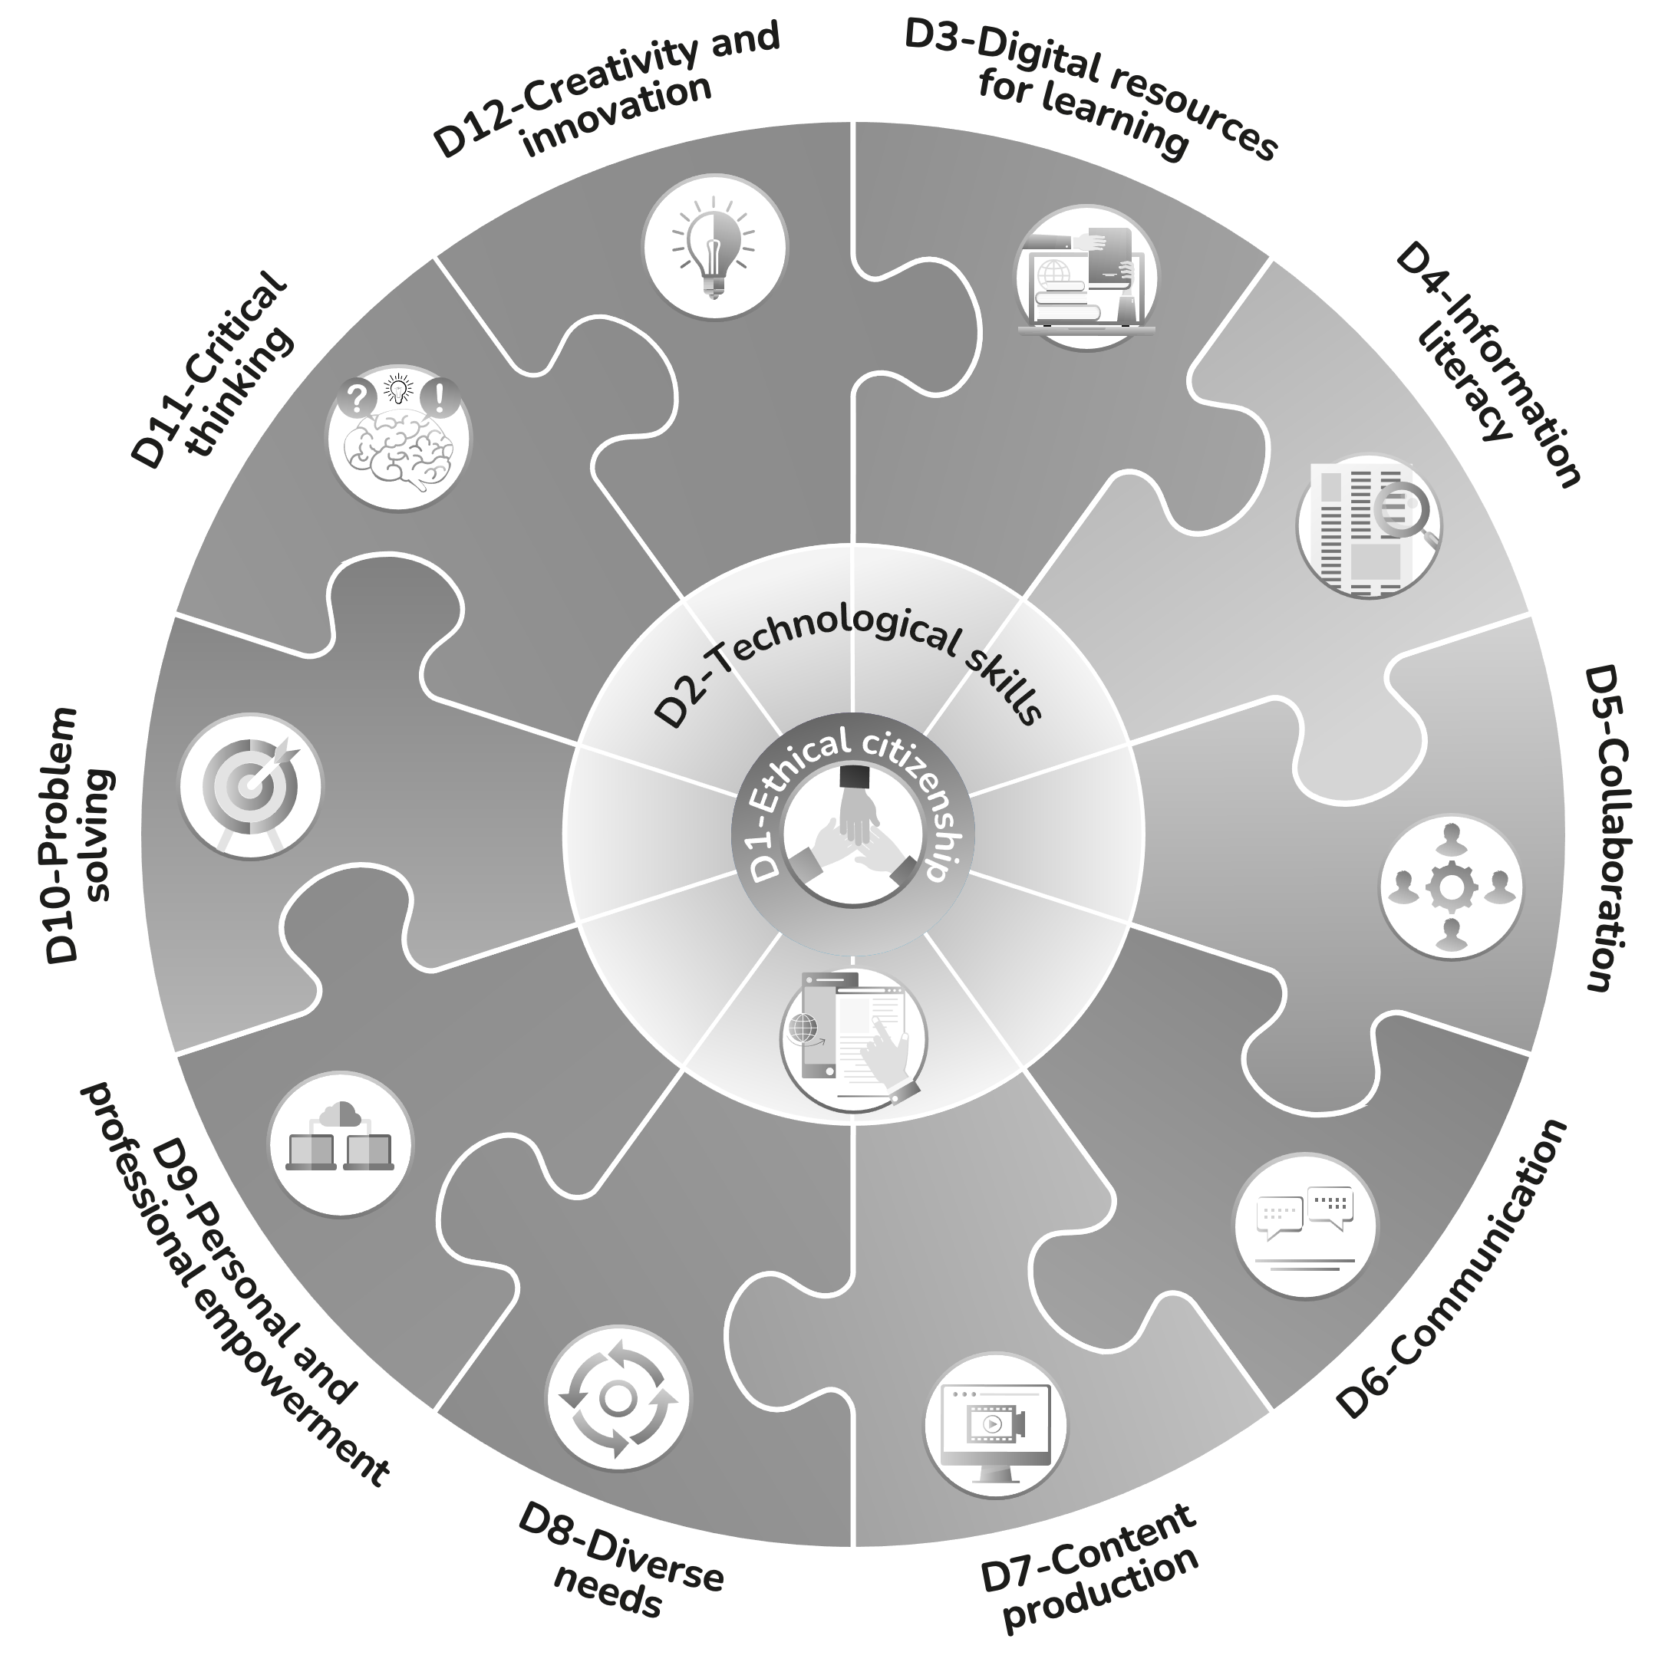

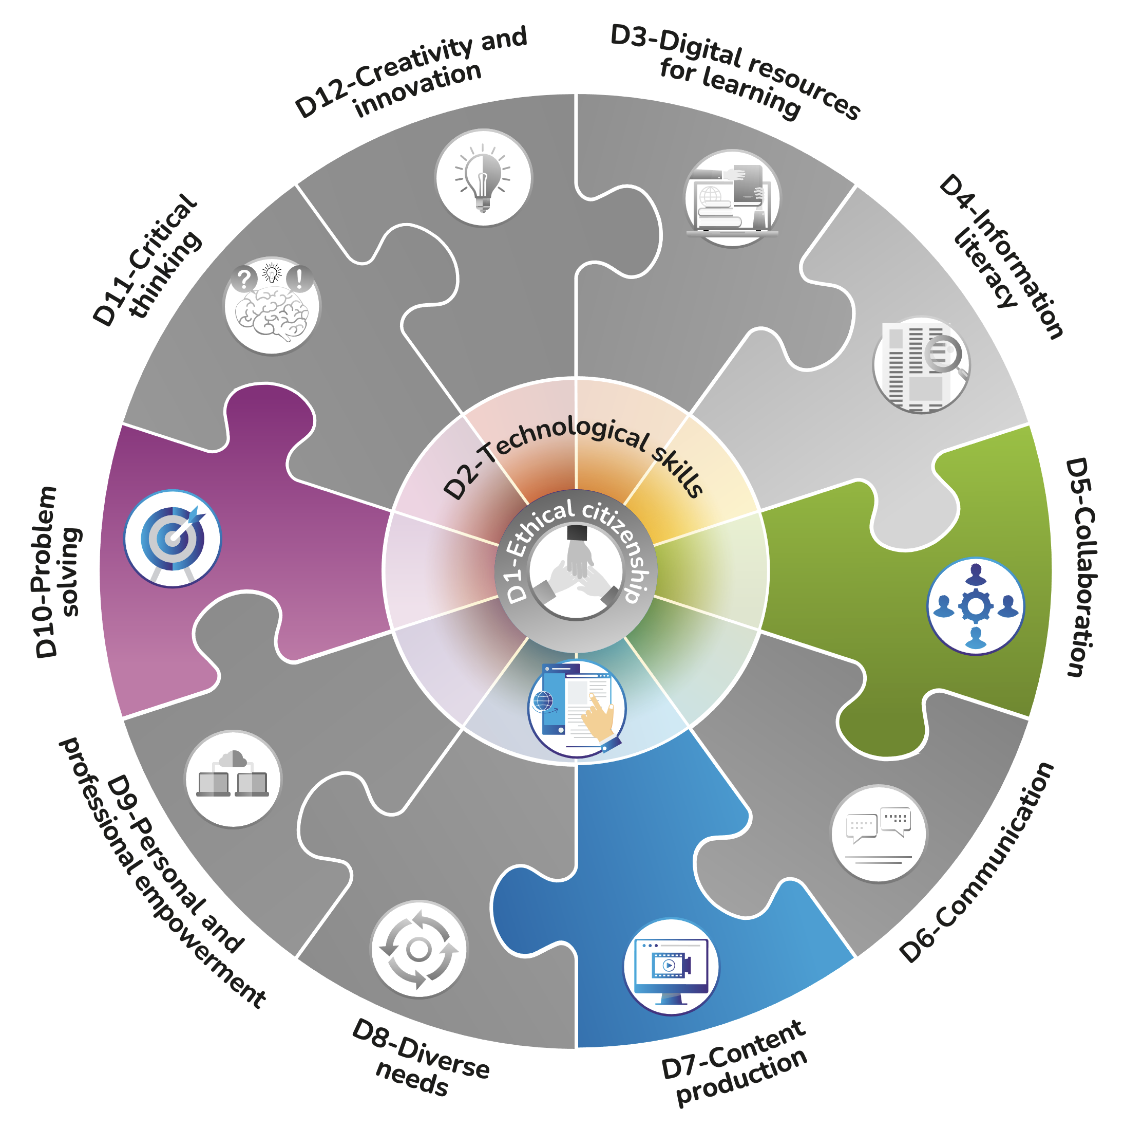
A few simple steps to highlight targeted dimensions
Go to slide 3.
Start the slide show at slide 3:
  Click on the Slide Show tab.
  In the “Start Slide Show” group, select “From Current Slide.”
Click on the dimensions you want to highlight.
Take a screenshot and save it in the format of your choice.

Slide 3
*See slide 2 for instructions.

Slide 4

Read the Digital Competency Framework and discover complementary resources for digital competency development on Quebec.ca.

